Slide 1
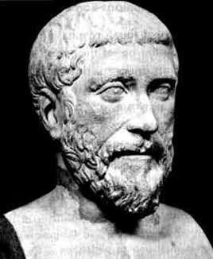
a² + b² = c²
also known as the
PYTHAGOREAN THEOREM

Slide 2
Pythagorean Theorem
Getting to know the mind behind the theorem: PYTHAGORAS
Lifetime: circa 582 BC – circa 507 BC
Born : on the island of Samos (a Greek island in the Eastern Aegean), off the coast of Asia Minor.
Life Stages: Pythagoras left his native city for Croton, Calabria, in Southern Italy, to escape the tyrannical government of Polycrates.
Pythagoras established a secret religious society. His followers were called the Pythagoreans.
Main Interests: Metaphysics, Music, Mathematics, Ethics, Politics

Slide 3
Pythagorean Theorem
The Pythagorean Theorem works only with
RIGHT TRIANGLES
HYPOTENUSE
The longest side of a right triangle
Always located opposite of the right angle

Slide 4
Pythagorean Theorem
a² + b² = c²
c
a
b

Slide 5
Pythagorean Theorem
Find the area if
a = 4cm and..
a² + b² = c²
4² + b² = c²
c
4
b

Slide 6
Pythagorean Theorem
…and if
b = 3cm
a² + b² = c²
4² + b² = c²
4² + 3² = c²
c
4
3

Slide 7
Pythagorean Theorem
area of square a
+
area of square b
=
area of square c
c
OR
4² + 3² = c²
4
3

Slide 8
Pythagorean Theorem
4² + 3² = c²
16 + 9 = c²
25 = c²
c
4
3

Slide 9

Pythagorean Theorem
Now that you know the area of the square of c, how do you find the length of one side of the square of c?
c
HINT, HINT!

Slide 10
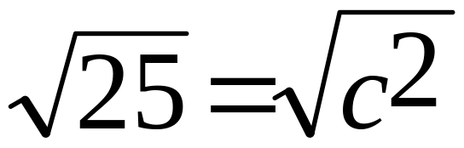
Pythagorean Theorem
You got it!
Find the square ROOT of each side of the equal sign.
c

Slide 11
Pythagorean Theorem
5
5 cm = c

Slide 12
Pythagorean Theorem
Let's Practice...
a² + b² = c²
What is the length of the hypotenuse?
11 cm
c
4 cm

Slide 13
Pythagorean Theorem
Step-by-Step...
a² + b² = c²
1. Write the formula. a² + b² = c²
11 cm
c
4 cm

Slide 14
Pythagorean Theorem
Step-by-Step...
a² + b² = c²
1. Write the formula. a² + b² = c²
2. Plug in the numbers. 11² + 4² = c²
11 cm
c
4 cm

Slide 15
Pythagorean Theorem
Step-by-Step...
a² + b² = c²
1. Write the formula. a² + b² = c²
2. Plug in the numbers. 11² + 4² = c²
3. Solve. (exponents to standard form) 121 + 16 = c²
11 cm
c
4 cm

Slide 16
Pythagorean Theorem
Step-by-Step...
a² + b² = c²
1. Write the formula. a² + b² = c²
2. Plug in the numbers. 11² + 4² = c²
3. Solve. (exponents to standard form) 121 + 16 = c²
4. Add standard forms. 137 = c²
11 cm
c
4 cm

Slide 17

Pythagorean Theorem
Step-by-Step...
a² + b² = c²
1. Write the formula. a² + b² = c²
2. Plug in the numbers. 11² + 4² = c²
3. Solve. (exponents to standard form) 121 + 16 = c²
4. Add standard forms. 137 = c²
5. Find square roots.
11 cm
c
4 cm

Slide 18
Pythagorean Theorem
Step-by-Step...
a² + b² = c²
1. Write the formula. a² + b² = c²
2. Plug in the numbers. 11² + 4² = c²
3. Solve. (exponents to standard form) 121 + 16 = c²\
4. Add standard forms. 137 = c²
5. Find square roots.
6. Label. 11.7 cm = c
11 cm
c
4 cm

Slide 19
Pythagorean Theorem
Let's Practice...
a² + b² = c²
What is the length of the hypotenuse?
c
2 in.
4.5 in.

Slide 20
Pythagorean Theorem
Let's Practice...
a² + b² = c²
Write the formula. a² + b² = c²
c
2 in.
4.5 in.

Slide 21
Pythagorean Theorem
Let's Practice...
a² + b² = c²
Write the formula. a² + b² = c²
Plug in the numbers. 2² + 4.5² = c²
c
2 in.
4.5 in.

Slide 22
Pythagorean Theorem
Let's Practice...
a² + b² = c²
Write the formula. a² + b² = c²
Plug in the numbers. 2² + 4.5² = c²
Solve. (exponents to standard form) 4 + 20.25 = c²
c
2 in.
4.5 in.

Slide 23
Pythagorean Theorem
Let's Practice...
a² + b² = c²
Write the formula. a² + b² = c²
Plug in the numbers. 2² + 4.5² = c²
Solve. (exponents to standard form) 4 + 20.25 = c²
Add standard forms. 24.25 = c²
c
2 in.
4.5 in.

Slide 24

Pythagorean Theorem
Let's Practice...
a² + b² = c²
Write the formula. a² + b² = c²
Plug in the numbers. 2² + 4.5² = c²
Solve. (exponents to standard form) 4 + 20.25 = c²
Add standard forms. 24.25 = c²
Find square roots.
c
2 in.
4.5 in.

Slide 25
Pythagorean Theorem
Let's Practice...
a² + b² = c²
Write the formula. a² + b² = c²
Plug in the numbers. 2² + 4.5² = c²
Solve. (exponents to standard form) 4 + 20.25 = c²
Add standard forms. 24.25 = c²
Find square roots.
Label. 4.92 in. = c
c
2 in.
4.5 in.

Slide 26
Pythagorean Theorem
a² + b² = c²
More Practice...
What is the length of the hypotenuse?
c
9.6 cm
10.3 cm

Slide 27
Pythagorean Theorem
a² + b² = c²
More Practice...
What is the length of the hypotenuse?
c = 14.08 cm
9.6 cm
10.3 cm

